Slide 1
PRESENTATION ON AIR RESERVATION SYSTEM C++
PRESENTED BY :
FAIZAM AHAMD
ENROLLMENT NO : 2015-301-021
SUBMITED TO :
MR. NAFISUR RAHMAN

Slide 2
CONTENTS TABLE
S.no CHAPTER PAGE NO
1. Title 1
2. Objective 2
3. Introduction 3
4. Problem Statement 4
5. Context Flow Diagram 5

Slide 3
6. Level 1 DFD 6
7. Entity Relationship diagram 7
8. Snapshots 8-12
9. Conclusion 13
10. Limitations and Future Scope 14-15
11. Bibliography 16

Slide 4

AIR Reservation System

Slide 5
Objective
Provide some amount about airline management.
Help your airline business to create more efficient.
An additional attraction for your potential customers.
It will also show the attitude of new people.
Technological techniques and ready to adopt them.

Slide 6
INTRODUCTION
This project on the “Air Reservation System” is the automation of the airline system's
registration process. The system is capable of providing much Information like
passenger information, ticket cancellation, list of all passengers, etc. This system
allows us to add records at the time when a passenger ticket book. For data collection
and recovery, we use the C languages is the file-handling feature.

Slide 7
Problem Statement
Before creating this application, we considered that it was very difficult to handle our customers, the only line that had just started operations.
This was due to his great customer service and friendly operations. The problem is that in the tagline recording keeping system, the employment of excessive employees is required, very time consuming process involves both the customers as well as for manager inconveniences.
Slowly & slowly these customers started to grow very rapidly

Slide 8
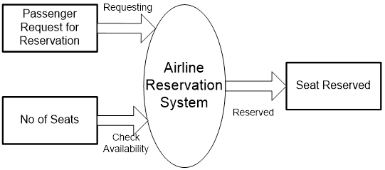
Context Flow Diagram

Slide 9
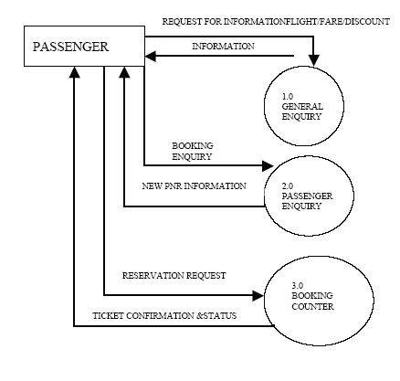
Level 1 DFD

Slide 10
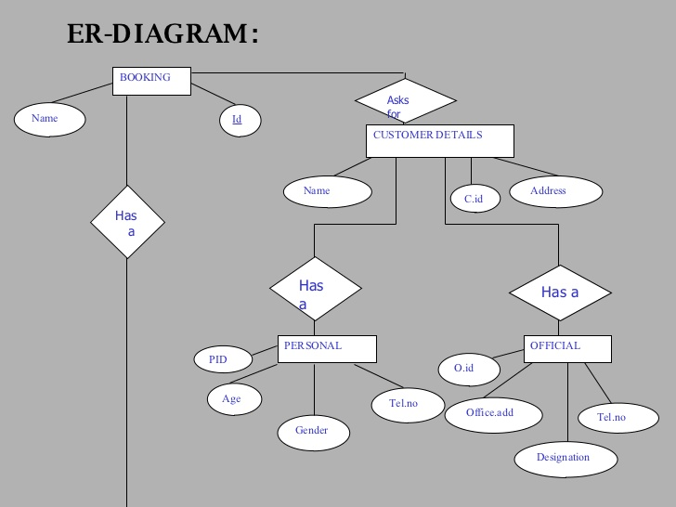
Entity Relationship Diagram

Slide 11
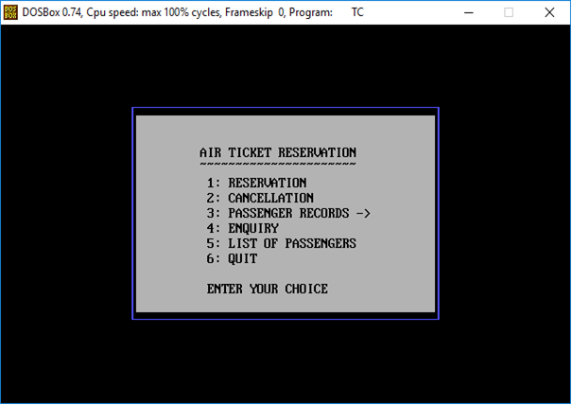
Snapshots
Main Menu

Slide 12
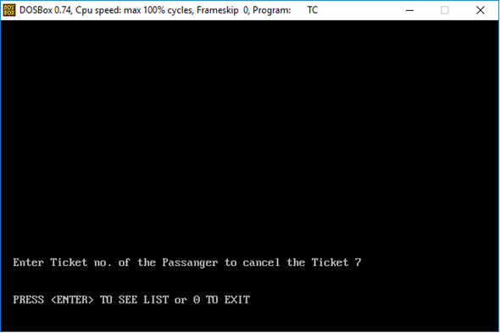
CANCLE TICKET NO.

Slide 13
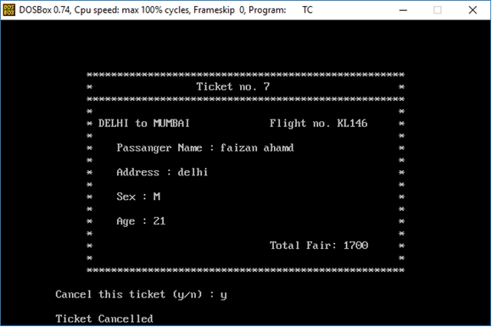
Cancel Ticket

Slide 14
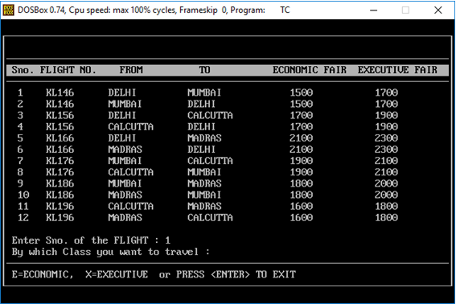
Reservation Steps 1

Slide 15
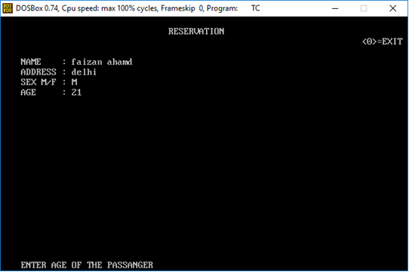
Reservation Steps 2

Slide 16
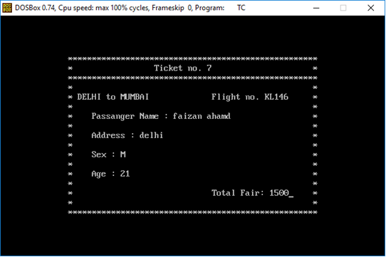
Reservation Ticket

Slide 17
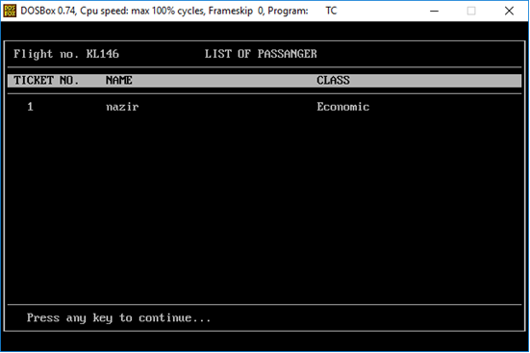
List of Passengers

Slide 18
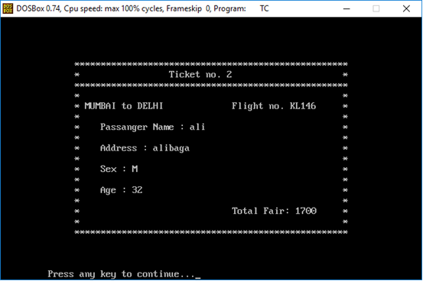
Passenger Records

Slide 19
Limitations and Future Scope
Limitations
This section includes the return of the
time of booking the seat and the collection of tickets,
this section also includes the date of booking and the
name of the agent is optional, through which the
customer has booked the booking for his visit.
As they maintain the register, searching for any
particular record is extremely difficult.
Maintaining number of records is also very cumbersome.

Slide 20
Future Scope
The scope of this project is to replace the System with New Advanced Computerized System to use this software, the user does not need any further training
It also changes all the paperwork.
While transferring any customer, such as incoming customers, if you want to know The number of incoming customers, this will be our very easy desire.

Slide 21
CONCLUSION
“AIR Reservation System” Software Admin can do the ticket reservations and cancellation.
It is very much helpful in maintaining Reservation System.
By making this AIR Reservation System it reduces the manpower.
It is very help full in maintaining the ticket reservation where ever it is used. In this AIR Reservation System many updating can be possible.

Slide 22
Bibliography
1. E. Balagurusamy, Object Oriented Programming
with C++ Tata McGraw-Hill Publishing house,
Copyright 1998.
2. The ‘C’ Programming language by Kernighan &
Ritchie, Prentice Hall Publishing House, Copyright
1988.
3. Teach yourself C by Yashwant Kanetkar, BPb Publishing
house edition-6th.
4. Alan Ensues, Paul Enzust, an Introduction to Design Patterns in C++ with Qt4, Prentice Hall, 2007

